Slide 1

Polysilicon vs Metal: A Glimpse on MOSFETs’ Design Challenges
Rastin Maleki
Supervisor: Dr. Mahdi Aminian

Slide 2

Overview
Introduction
Polysilicon Replacing Metals
The Problem: Unwanted Gate-Active Capacitors
The Solution: Self-Aligned Process
Resolved Challenges
The Problem: Velocity Saturation & Mobility Degradation
The Solution: Strained Silicon
The Problem: Junction Parasitic Capacitors
The Solution: Silicon on Insulator
Metal Gates Return
The Problem: Gate Leakage
The Solution: High-K Gate Materials
Conclusion & Final Notes
References

Slide 3



Introduction
In early days of MOSFET (Metal-Oxide-Semiconductor-Field-Effect-Transistor) introduction, Aluminum was chosen as gate material.
In late 70’, Aluminum was replaced with Polysilicon.
In early 2000’s, metal gates returned.

Slide 4
Polysilicon Replacing Metals

Slide 5
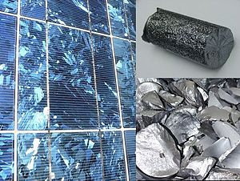
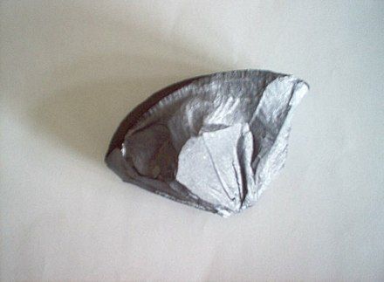
Polysilicon Replacing Metals
Polycrystalline silicon, also called Polysilicon, poly-Si, or mc-Si, is a high purity, polycrystalline form of silicon, used as a raw material by the solar photovoltaic and electronics industry.
In late 70’s Aluminum was replaced with Poly-Si.P

Slide 6
The Problem: Unwanted Gate-Active Capacitors
Unwanted capacitors make things run slower.
Gate
Oxide
N+
N+
P+

Slide 7
The Problem: Unwanted Gate-Active Capacitors
As Technologies scaled down, the problem got worse.
Gate
N+
Oxide
N+
P+

Slide 8
The Problem: Unwanted Gate-Active Capacitors
Fabrication process used to be like this:
Gate
N+
Oxide
N+
P+

Slide 9
The Solution: Self-Aligned Process
The solution lies within improving fabrication process.
Self-Aligned Process is a fabrication process in which the gate comes first and acts as a mask during diffusion. (Gate Last method)
What’s the problem with Aluminum?
Gate
N+
Oxide
N+
P+

Slide 10
Metal Gates Replacement
Aluminum has a melting point of 660 degrees and annealing in Diffusing requires about 1000 degrees. So Aluminum would melt as mask.
Since Poly Silicon has a melting point of 1400 degrees, it would be a suitable replacements.
Other reasons: High Threshold voltage

Slide 11
Resolved Challenges

Slide 12
Resolved Challenges
As transistors scaled down, many challenge arose. Yet, not all challenges lead to Gate material reconsideration.
Some of which were solved brilliantly. We will be discussing:
Velocity Saturation & Mobility Degradation
Junction Parasitic Capacitors

Slide 13
The Problem: Velocity Saturation & Mobility Degradation
As technologies scaled down, moving around became difficult for carriers.
Idea is simple: Creating more space!

Slide 14
The Solution: Strained Silicon
Strained Silicons are literally Strained!
This is how they’re made:

Slide 15
The Solution: Strained Silicon
Figure below is a Tensile Strain.
There are two types of Strained Silicon:
Compressive Strain
Tensile Strain

Slide 16
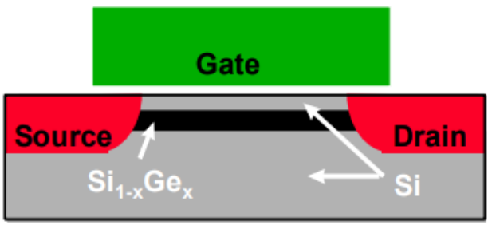
The Solution: Strained Silicon
Si on Si-Ge is the key.
Tensile Strained Silicon

Slide 17
The Problem: Junction Parasitic Capacitors
P-N junctions form Parasitic Capacitors.
The idea is once again simple: Getting rid of the p!
Gate
N+
Oxide
N+
P+

Slide 18
The Solution: Silicon on Insulator
A thin Silicon Layer is enough for carriers, the rest is waste.
Two types:
Fully Depleted
Partially Depleted (Also Called Ultra-Thin Body SOI)
Gate
N+
Oxide
N+
P+
Buried Oxide
Substrate

Slide 19
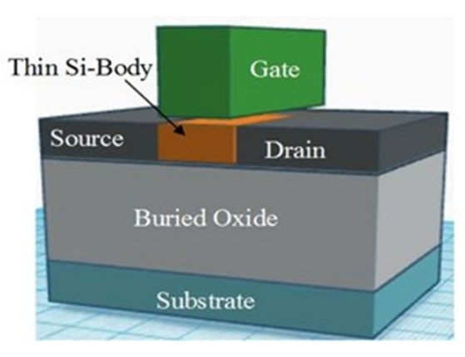
The Solution: Silicon on Insulator
Less dynamic delay and power
Less leakage currents at subthreshold voltages
FD SOIs are difficult to make
Heating also is a downside, leading to mobility and current degradation
SOI device in details

Slide 20
Metal Gates Return

Slide 21
Metal Gates Return
For the first time, Intel launched their 45-nm parts on Nov 12 2007 using metal gates with a high-k dielectric layer.
So why the switch back?

Slide 22
The Problem: Gate Leakage
As Technologies scaled down, the dielectric became thinner.
The thinner the dielectric, the easier it is for Electrons to tunnel through it.
What if we don’t scale it?
Gate
Leakage!
Oxide
P+
N+
N+

Slide 23
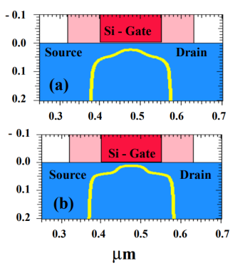
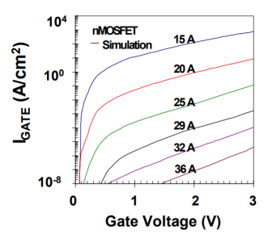
The Problem: Gate Leakage
The thicker the dielectric, the thicker the depletion layer. Meaning higher threshold voltage.
Comparing leaked current with various oxide layer thickness
Comparing depletion layer thickness between a 3.2um (bottom) dielectric and 4.5um (top) dielectric

Slide 24
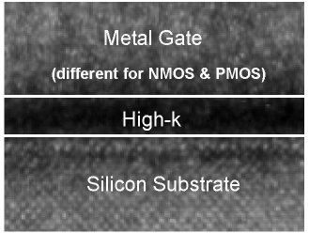
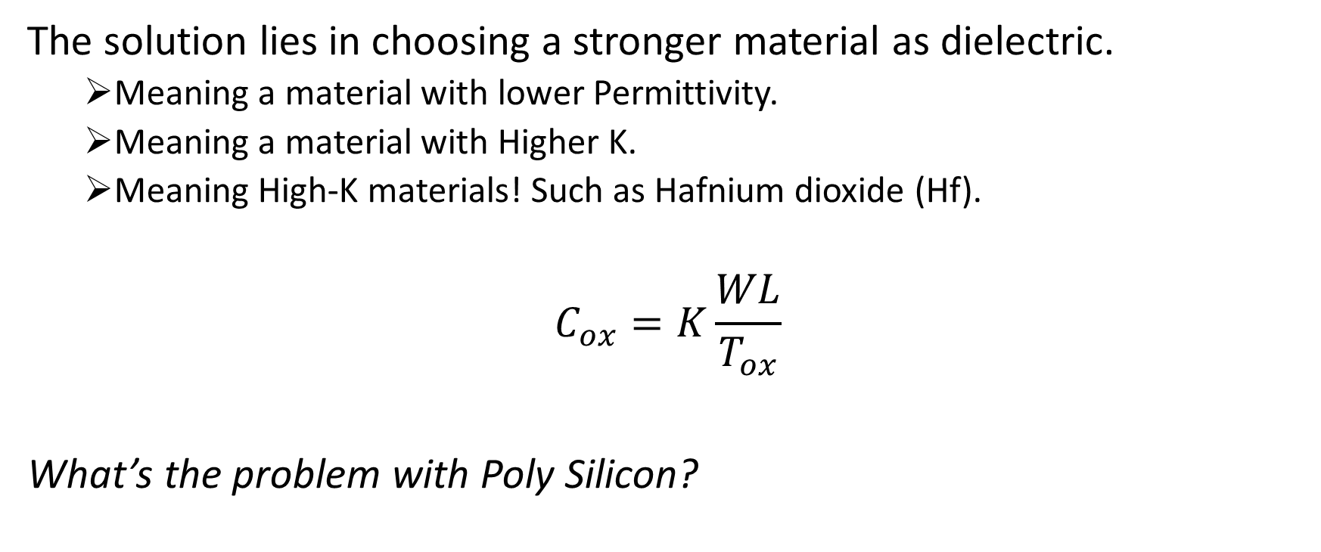
The Solution: High-K Materials
The solution lies in choosing a stronger material as dielectric.
Meaning a material with lower Permittivity.
Meaning a material with Higher K.
Meaning High-K materials! Such as Hafnium dioxide (Hf).
$$C_{ox}=K\frac{WL}{T_{ox}}$$
What’s the problem with Poly Silicon?
HKGM device

Slide 25
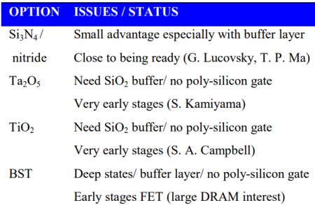
Poly-Si Gates Replacement
Polysilicon is not compatible with High-K materials. Therefore, a metal such as Tungsten is used as gate material.
How were things improvements?
Different options for High-K material

Slide 26
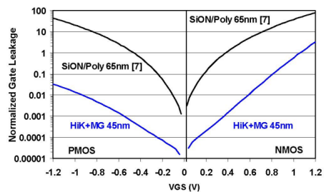
Poly-Si Gates Replacement
Improvements:
What happened to Self-Aligned Process?
Improvements on leakage using HKGM

Slide 27
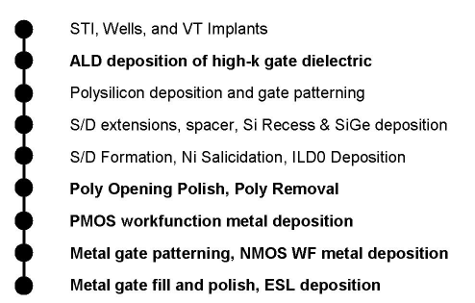
Poly-Si Gates Replacement
With the Metal Gate reintroduced, Self-Aligned process was never put aside. Instead, a more genuine solution was proposed.
Dummy Poly Silicon being used as mask, and later replaced with metal gate.
Transistor process flow

Slide 28

Conclusion & Final Notes
Switching From Metal to Polysilicon?
Resolved Challenges and Their Solutions?
Switching From Polysilicon to Metal?
“No exponential is forever: but "Forever" can be delayed!” – Gordon E. Moore.

Slide 29
References
Ahn, W. J. J.-H. (2017). Depletion effect of polycrystalline-silicon gate electrode by phosphorus deactivation. Solid-State Electronics, 127.
al, K. M. e. (2004). Delaying Forever: Uniaxial Strained Silicon Transistors in a 90nm CMOS Technology Digest of Technical Papers. 2004 Symposium on VLSI Technology, 2004., Honolulu, HI, USA.
al, K. M. e. (2007). A 45nm Logic Technology with High-k+Metal Gate Transistors, Strained Silicon, 9 Cu Interconnect Layers, 193nm Dry Patterning, and 100% Pb-free Packaging 2007 IEEE International Electron Devices Meeting, Washington, DC, USA.
Arns, R. G. (1998). The other transistor: early history of the metal-oxide-semiconductor field-effect transistor. ENGINEERING SCIENCE AND EDUCATION JOURNAL, 7(5).
James, D. (2012). High-k/Metal Gates in Leading Edge Silicon Devices 2012 SEMI Advanced Semiconductor Manufacturing Conference, Saratoga Springs, NY, USA.
Lad, P. H. V. R. A Review Paper on CMOS, SOI and FinFET Technology. https://www.design-reuse.com/articles/41330/cmos-soi-finfet-technology-review-paper.html

Slide 30
References
Neil H.E. Weste, D. H. (2015). CMOS VLSI Design : A circuits and systems perspective (4 ed.). Pearson.
Oishi, Y. A. T., Shiozawa, K., Tokuda, Y., & Satoh, S. (1999). Simulation Study on Comparison Between Metal Gate and Polysilicon Gate for Sub-Quarter-Micron MOSFET’s. IEEE ELECTRON DEVICE LETTERS, 20(12).
Packan, S. T. P., & Bohr, M. (1998). MOS Scaling: Transistor Challenges for the 21st Century. Intel Technology Journal, 3(98).
siliconvlsi. (2023). Diffusion and Ion Implantation. https://siliconvlsi.com/diffusion-and-ion-implantation/
SJÖBLOM, G. (2006). Metal Gate Technology for Advanced CMOS Devices Uppsala University]. Uppsala, Sweden.
Wallace, J. R. R. M. (2015). High-K materials and metal gates for CMOS applications. elsevier, 88.
دقیقی, ز. س. آ. (1398). بدست آوردن رابطه‌ی ولتاژ آستانه در ماسفت‌های سیلیکون روی الماس با طول کانال 22 نانومتر و یک لایه عایق اضافی. نشریه مهندسی برق و الکترونیک ایران, 16(2).

